Slide 1
Computational Fluid Dynamics (CFD)
DAY 7
Kumaresh

Slide 2
Contents
Explanation about Convection equation
Exercise

Slide 3
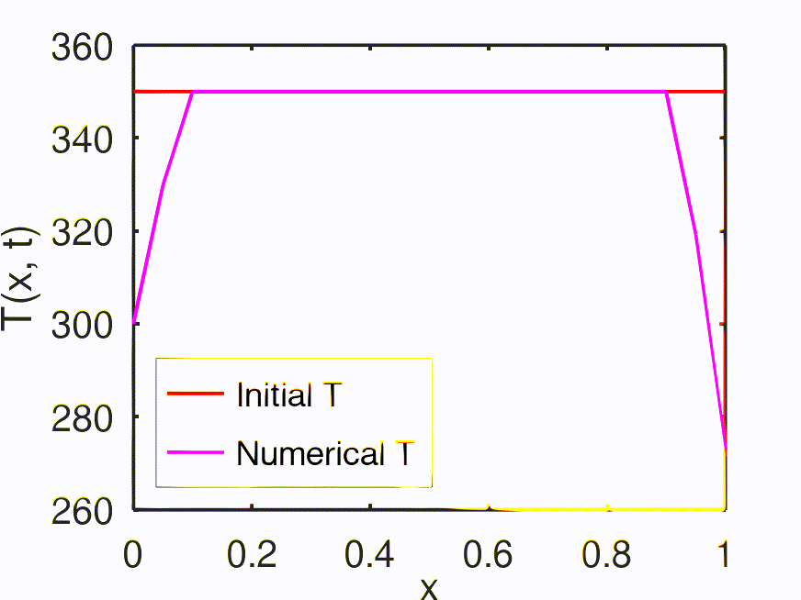
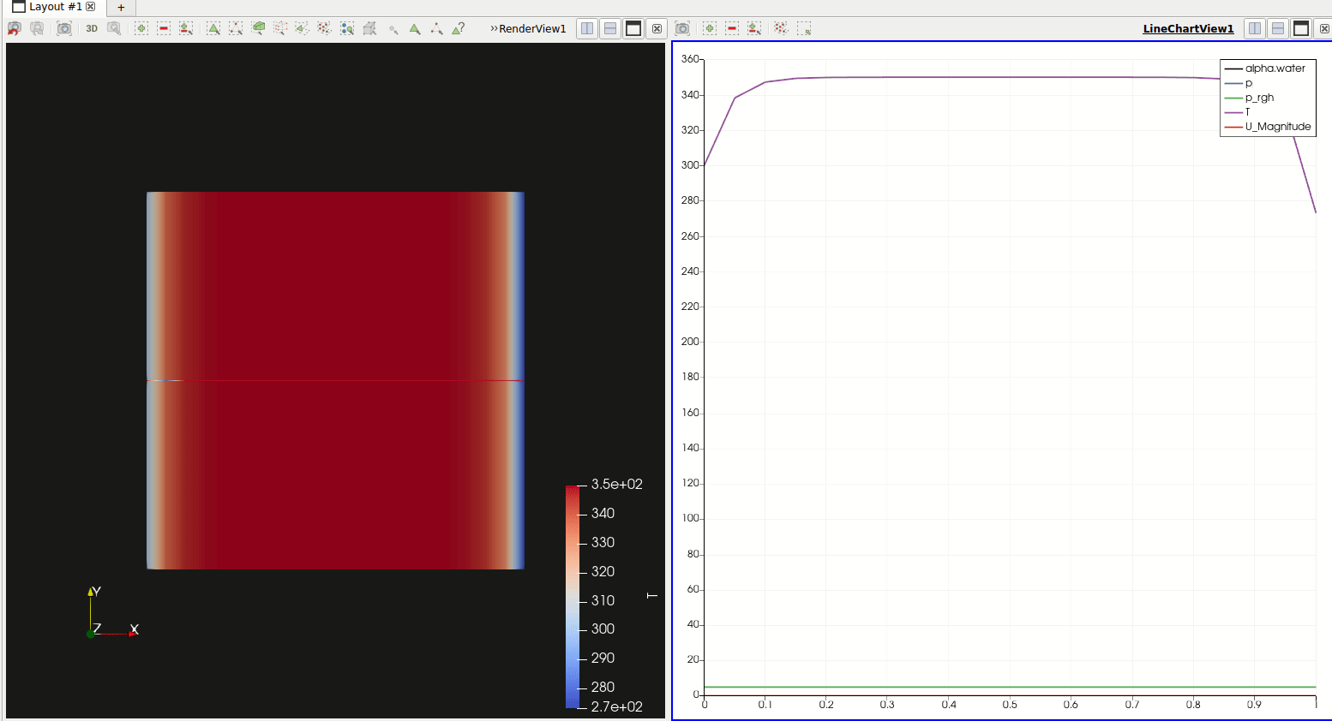
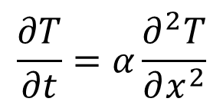
OpenFOAM: Numerical Solution to Diffusion Equation
Paraview – Post Processing tool in OpenFOAM
$$\frac{∂T}{∂t}=α\frac{∂^{2}T}{∂x^{2}}$$

Slide 4
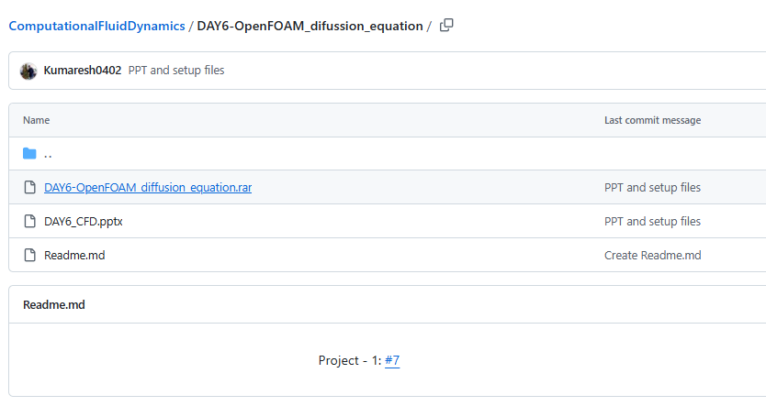
Extract files from GitHub

Slide 5
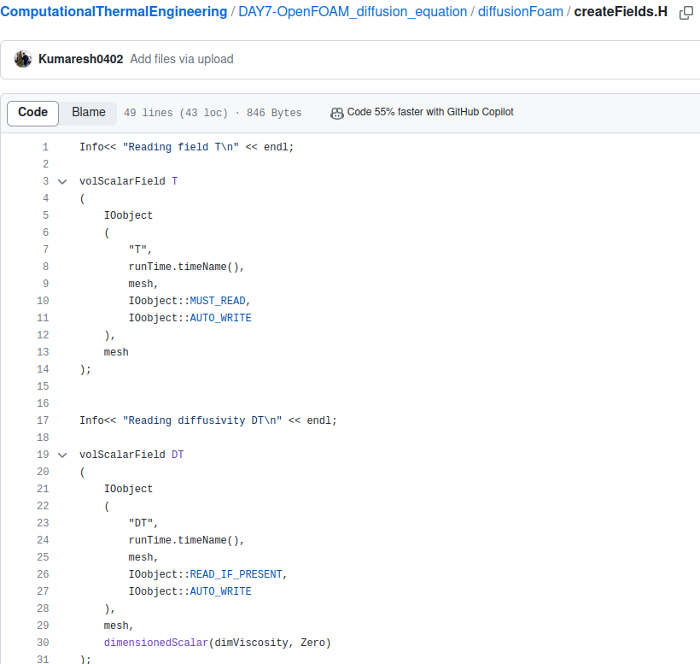
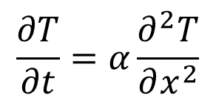
solver file ➔ diffusionFoam/createFields.H
$$\frac{∂T}{∂t}=α\frac{∂^{2}T}{∂x^{2}}$$
Temperature “T” field is created
Diffusivity as a field created

Slide 6
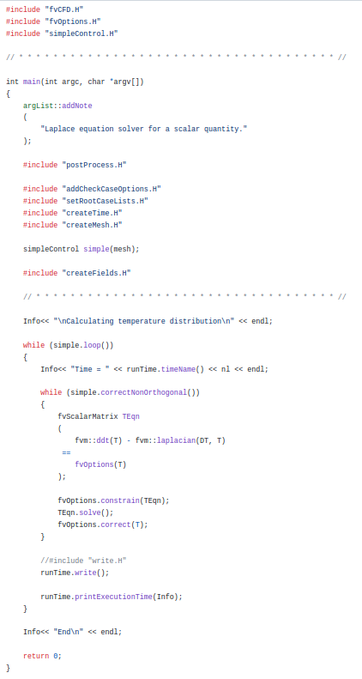
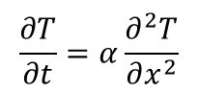
solver file ➔ diffusionFoam/diffusionFoam.C
Necessary “header” files
Matrix is created to solve “FVM”
$$\frac{∂T}{∂t}=α\frac{∂^{2}T}{∂x^{2}}$$

Slide 7
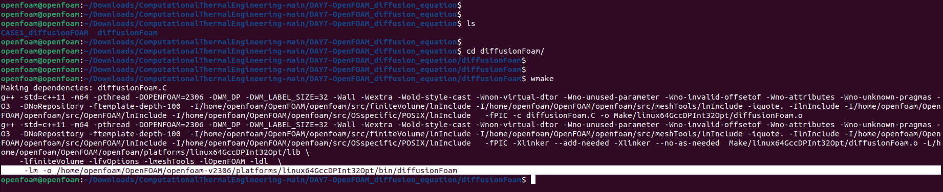
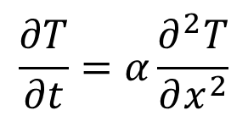
Compile diffusionFoam “solver”
$$\frac{∂T}{∂t}=α\frac{∂^{2}T}{∂x^{2}}$$
Compiled “diffusionFoam“ solver

Slide 8
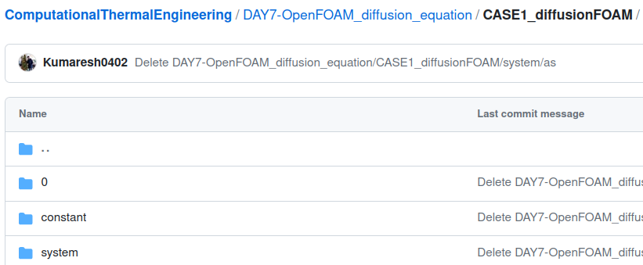
case file
$$\frac{∂T}{∂t}=α\frac{∂^{2}T}{∂x^{2}}$$
Initial conditions
Properties
Mesh, schemes, solvers, algorithm controls and tolerances for the implicit solvers.

Slide 9
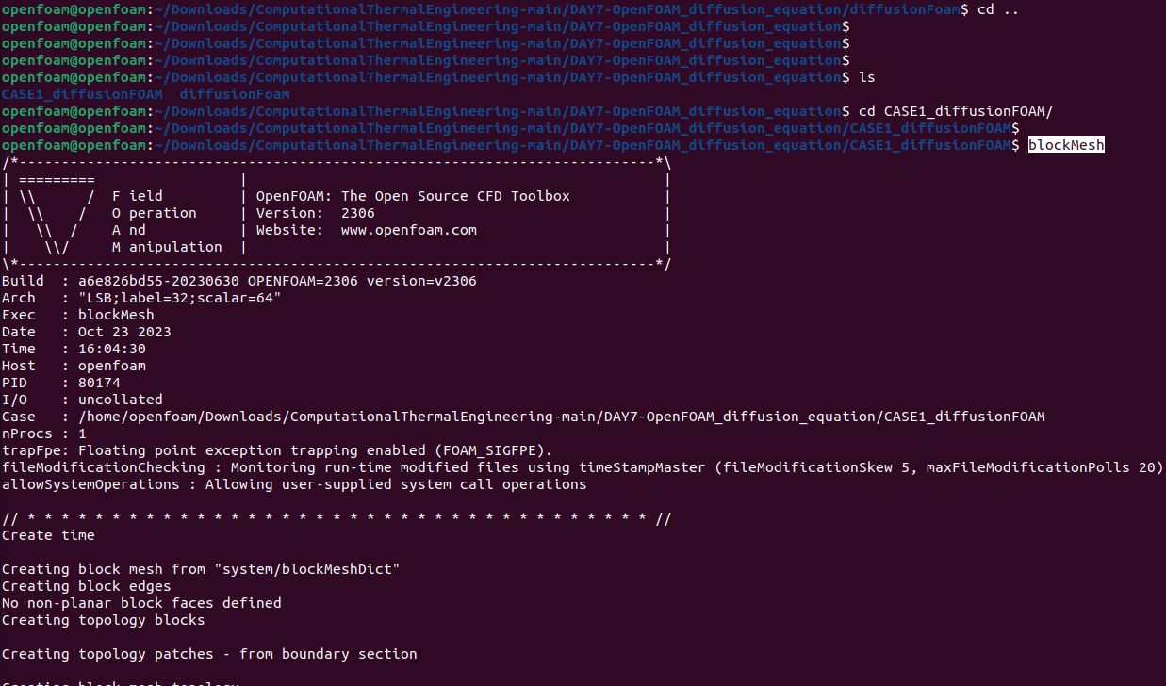
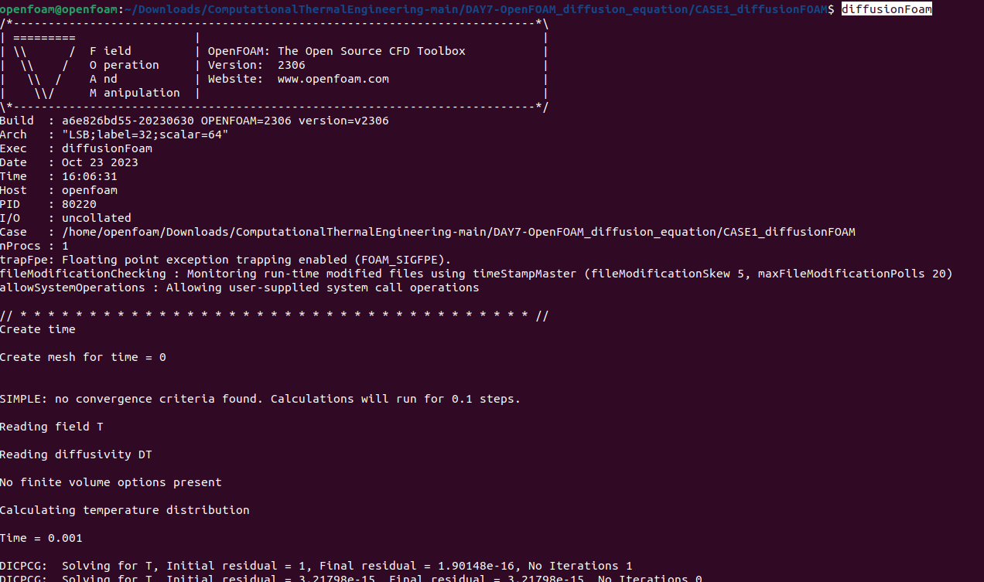
Compile the “case” file named – CASE1_diffusionFOAM
2
1

Slide 10
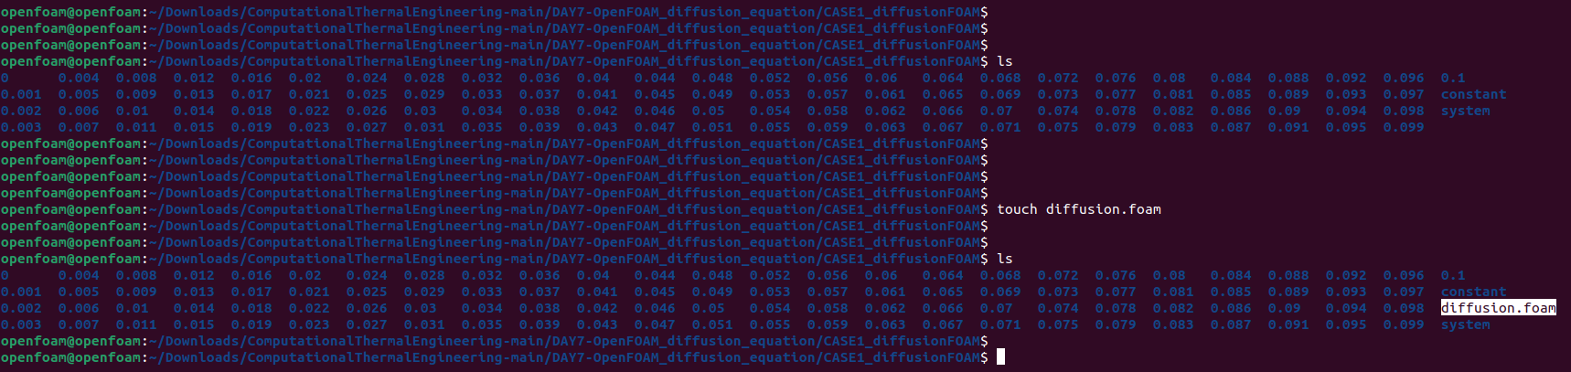
Compile the “case” file named – CASE1_diffusionFOAM
3

Slide 11
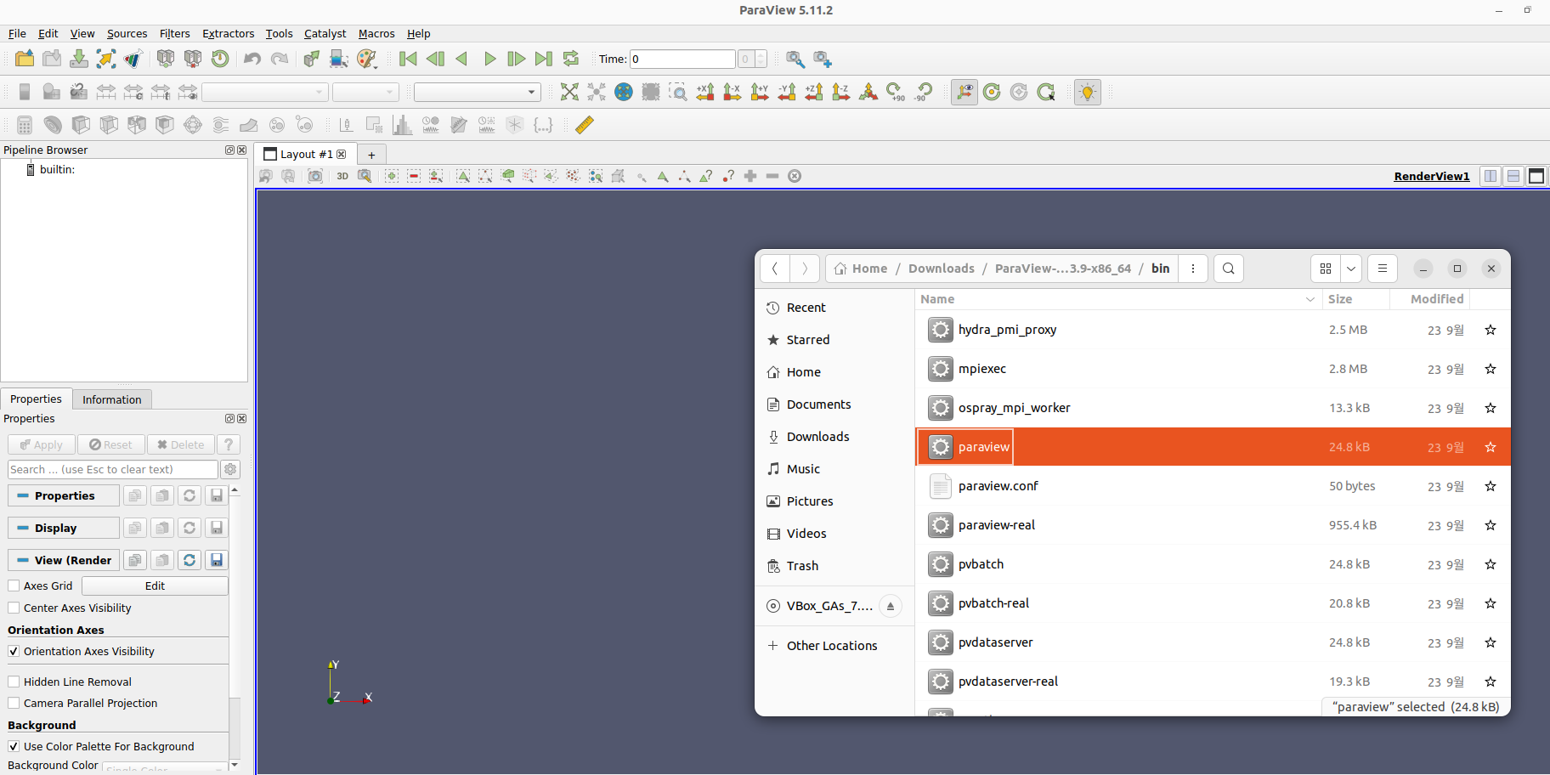
Open “Paraview”
Used for post-processing your results

Slide 12
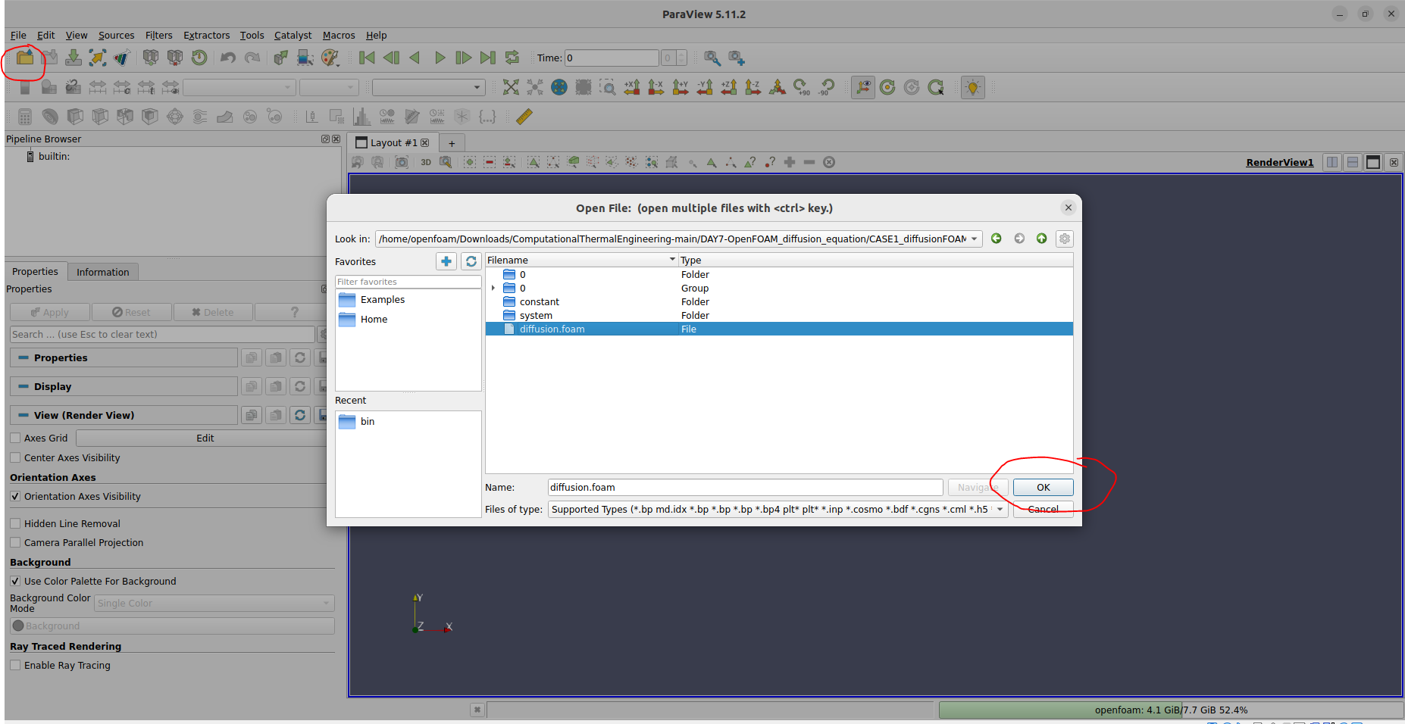
Open the “case” in paraview
4

Slide 13
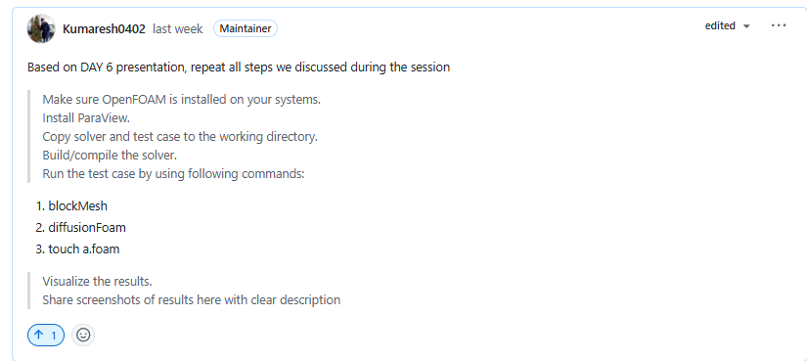
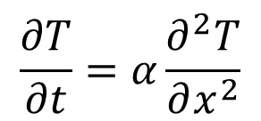
Project – 1 (Diffusion Equation using OpenFOAM)
$$\frac{∂T}{∂t}=α\frac{∂^{2}T}{∂x^{2}}$$

Slide 15
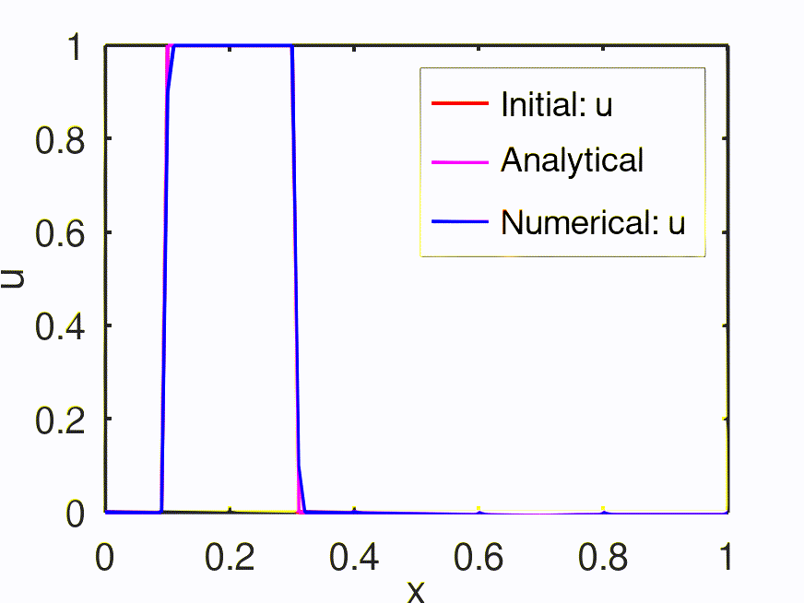
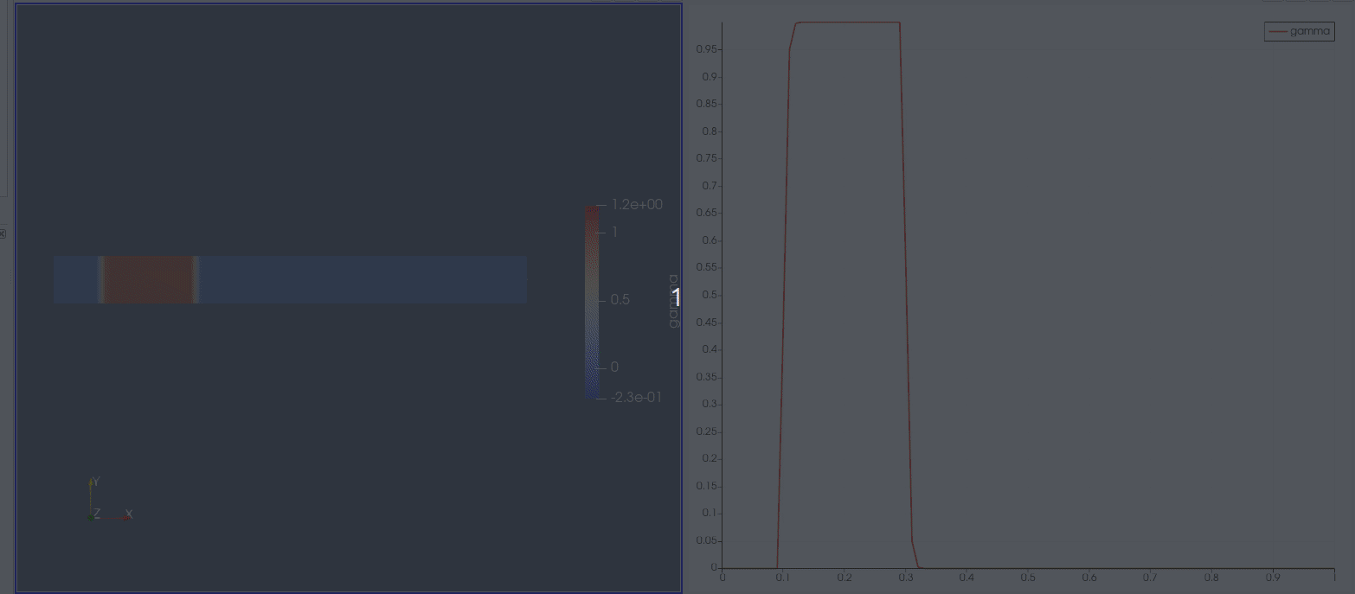
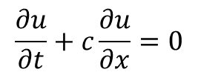
OpenFOAM: Numerical Solution to Convection Equation
$$\frac{∂u}{∂t}+c\frac{∂u}{∂x}=0$$

Slide 16
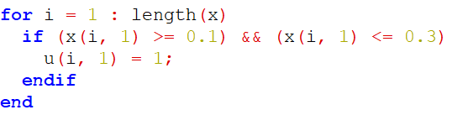
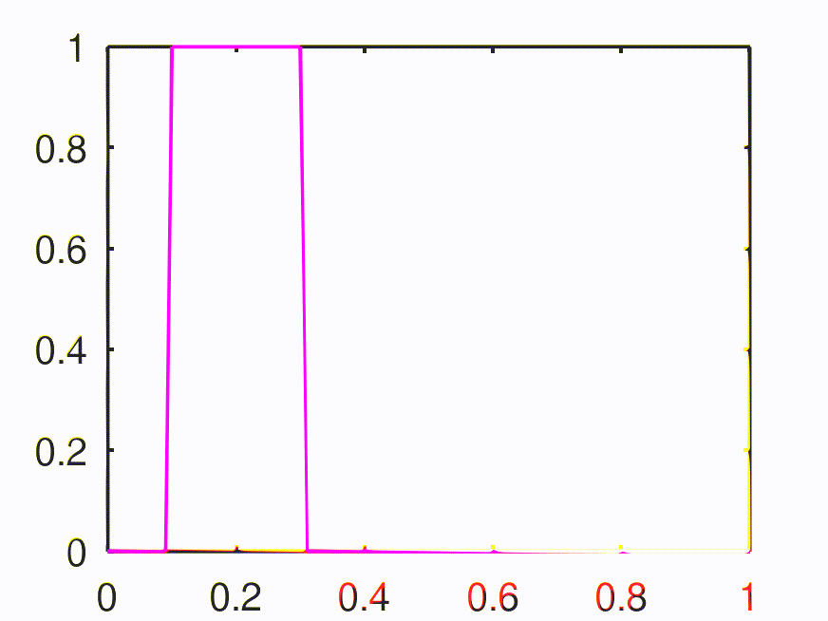
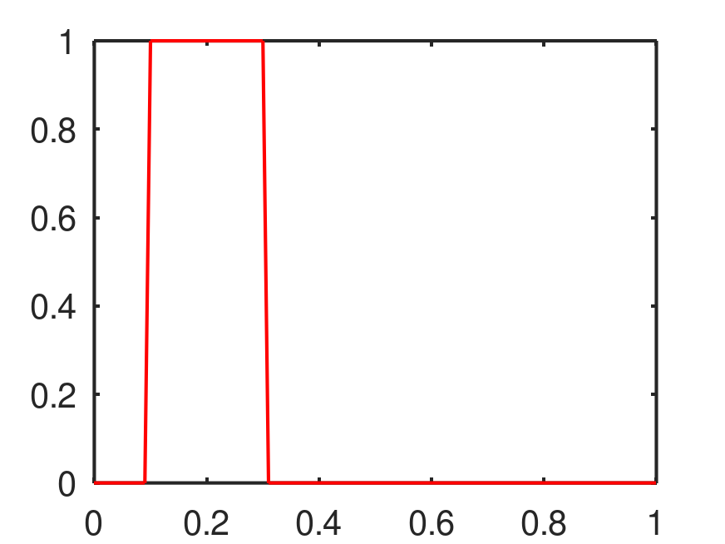
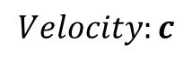
Convection Equation
Setting initial field
$$Velocity:c$$

Slide 17
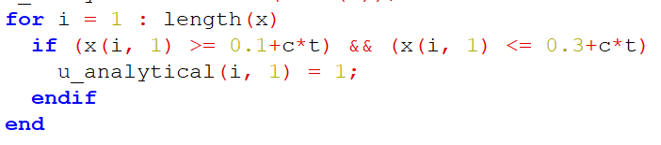
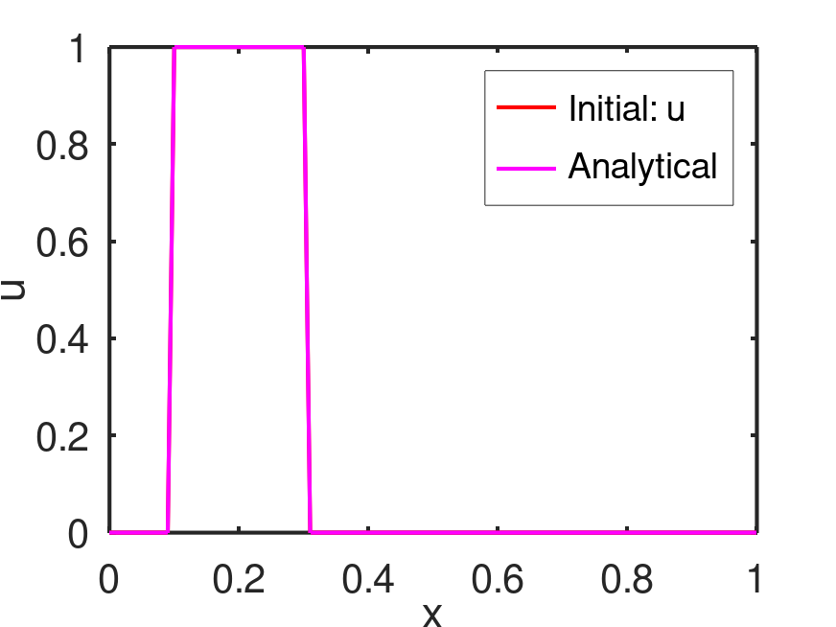
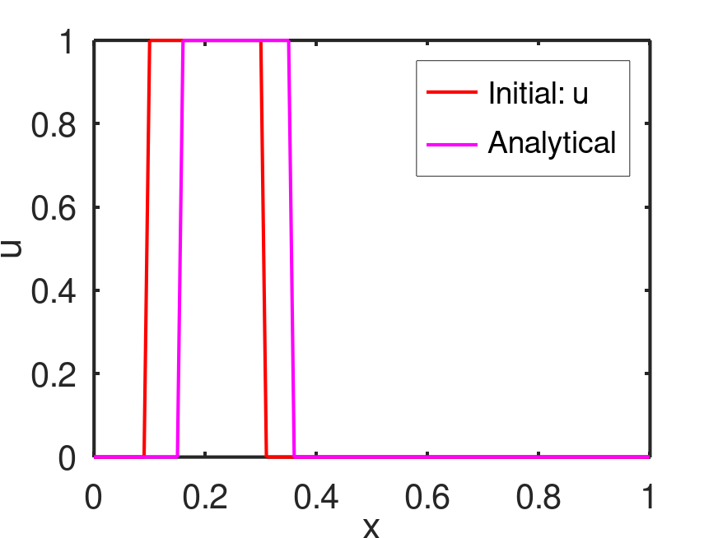
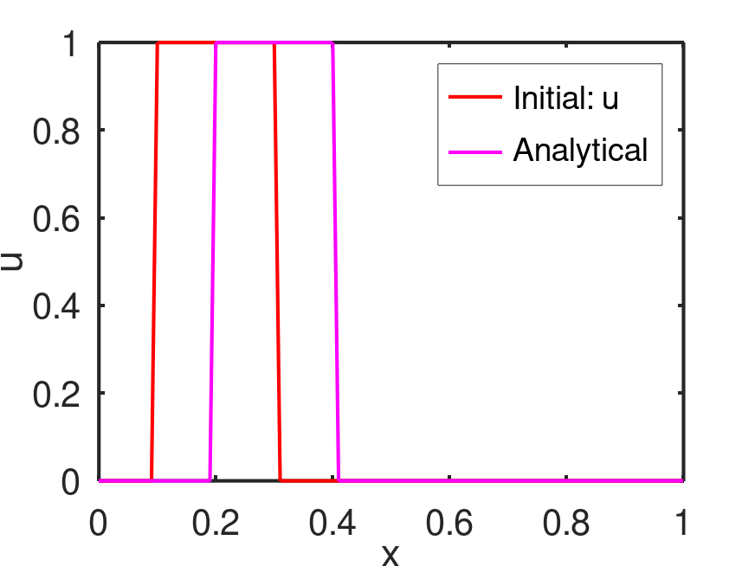
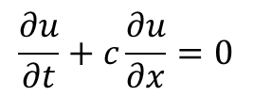
Convection Equation
$$\frac{∂u}{∂t}+c\frac{∂u}{∂x}=0$$
Advection equation

Slide 18
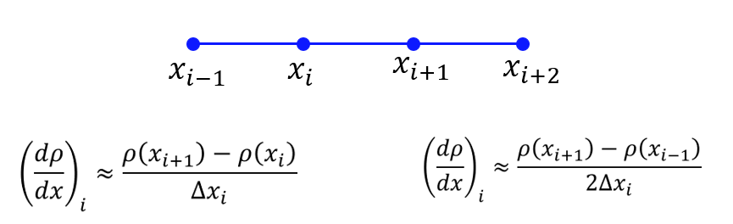
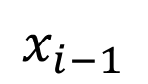
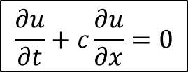
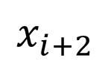
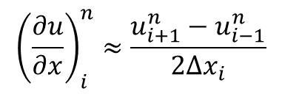
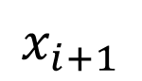
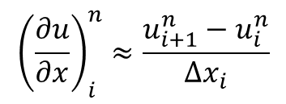
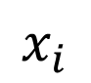
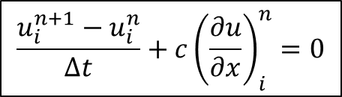
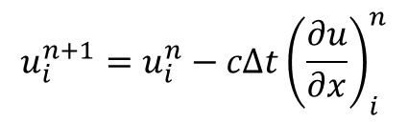
Convection Equation
$$\frac{∂u}{∂t}+c\frac{∂u}{∂x}=0$$
$$\frac{u_{i}^{n+1}−u_{i}^{n}}{Δt}+c{\left(\frac{∂u}{∂x}\right)}_{i}^{n}=0$$
$$x_{i−1}$$
$$x_{i}$$
$$x_{i+1}$$
$$x_{i+2}$$
$${\left(\frac{∂u}{∂x}\right)}_{i}^{n}≈\frac{u_{i+1}^{n}−u_{i}^{n}}{Δx_{i}}$$
Simple forward
difference scheme
$$u_{i}^{n+1}=u_{i}^{n}−cΔt{\left(\frac{∂u}{∂x}\right)}_{i}^{n}$$
$${\left(\frac{∂u}{∂x}\right)}_{i}^{n}≈\frac{u_{i+1}^{n}−u_{i−1}^{n}}{2Δx_{i}}$$
Central difference
(Explicit) First order - Forward Euler
(only one unknown (n+1) with other knowns at n^{th} node) → conditionally stable

Slide 19
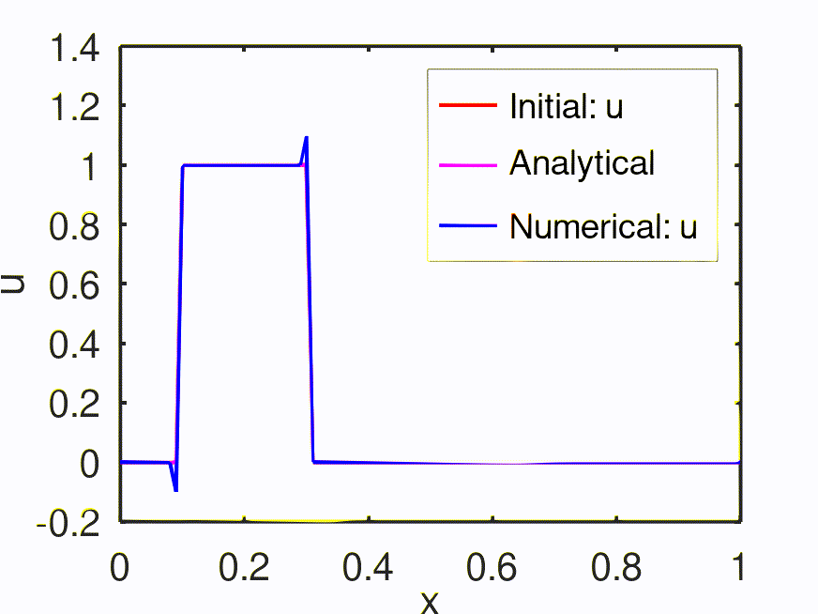
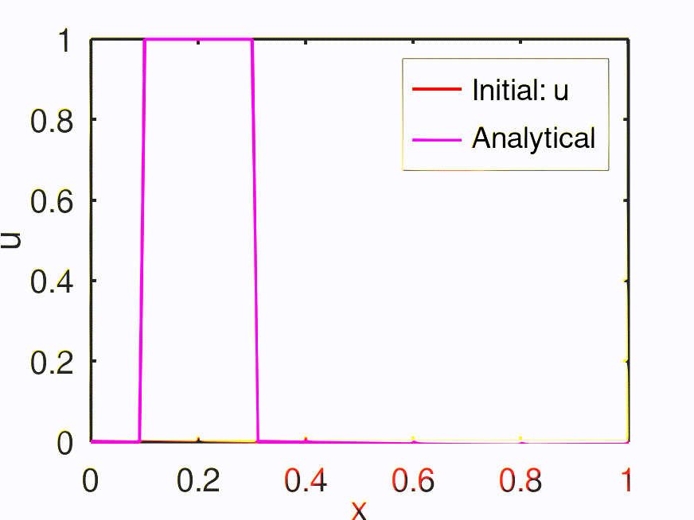
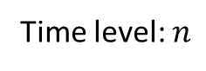
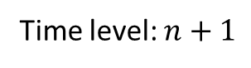
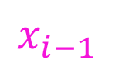
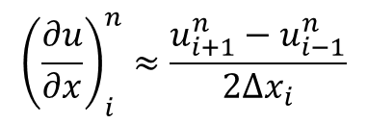
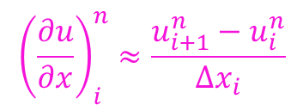
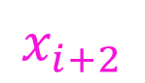
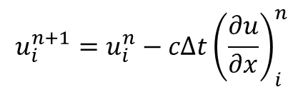
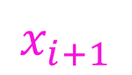

Convection Equation
Time level: $n+1$
$$x_{i−1}$$
$$x_{i}$$
$$x_{i+1}$$
$$x_{i+2}$$
Time level: $n$
$$x_{i+1}$$
$$x_{i+2}$$
$$x_{i−1}$$
$$x_{i}$$
Information from right to left end
$${\left(\frac{∂u}{∂x}\right)}_{i}^{n}≈\frac{u_{i+1}^{n}−u_{i}^{n}}{Δx_{i}}$$
Simple forward
difference scheme
$$u_{i}^{n+1}=u_{i}^{n}−cΔt{\left(\frac{∂u}{∂x}\right)}_{i}^{n}$$
$${\left(\frac{∂u}{∂x}\right)}_{i}^{n}≈\frac{u_{i+1}^{n}−u_{i−1}^{n}}{2Δx_{i}}$$
Central difference

Slide 20




Convection Equation
Time level: $n+1$
$$x_{i−1}$$
$$x_{i}$$
$$x_{i+1}$$
$$x_{i+2}$$
Time level: $n$
$$x_{i+1}$$
$$x_{i+2}$$
$$x_{i−1}$$
$$x_{i}$$
Information from left and right ends
$${\left(\frac{∂u}{∂x}\right)}_{i}^{n}≈\frac{u_{i+1}^{n}−u_{i}^{n}}{Δx_{i}}$$
Simple forward
difference scheme
$$u_{i}^{n+1}=u_{i}^{n}−cΔt{\left(\frac{∂u}{∂x}\right)}_{i}^{n}$$
$${\left(\frac{∂u}{∂x}\right)}_{i}^{n}≈\frac{u_{i+1}^{n}−u_{i−1}^{n}}{2Δx_{i}}$$
Central difference

Slide 21




Convection Equation
Time level: $n+1$
$$x_{i−1}$$
$$x_{i}$$
$$x_{i+1}$$
$$x_{i+2}$$
Time level: $n$
$$x_{i+1}$$
$$x_{i+2}$$
$$x_{i−1}$$
$$x_{i}$$
Information from left to right end
Wind is flowing from left end (bird moves from left to right)
$$u_{i}^{n+1}=u_{i}^{n}−cΔt{\left(\frac{∂u}{∂x}\right)}_{i}^{n}$$
$${\left(\frac{∂u}{∂x}\right)}_{i}^{n}≈\frac{u_{i}^{n}−u_{i−1}^{n}}{Δx_{i}}$$
Simple backward
difference scheme
$$CFL: \frac{cΔt}{Δx}$$
CFL < 1 → Numerically stable (conditionally stable based on the condition imposed by CFL) – EXPLICIT method
CFL > = 1 → Numerically unstable
CFL = 0.1

Slide 22


Project – 2 (Convection Equation using OpenFOAM)
$$\frac{∂u}{∂t}+c\frac{∂u}{∂x}=0$$

